Slide 1
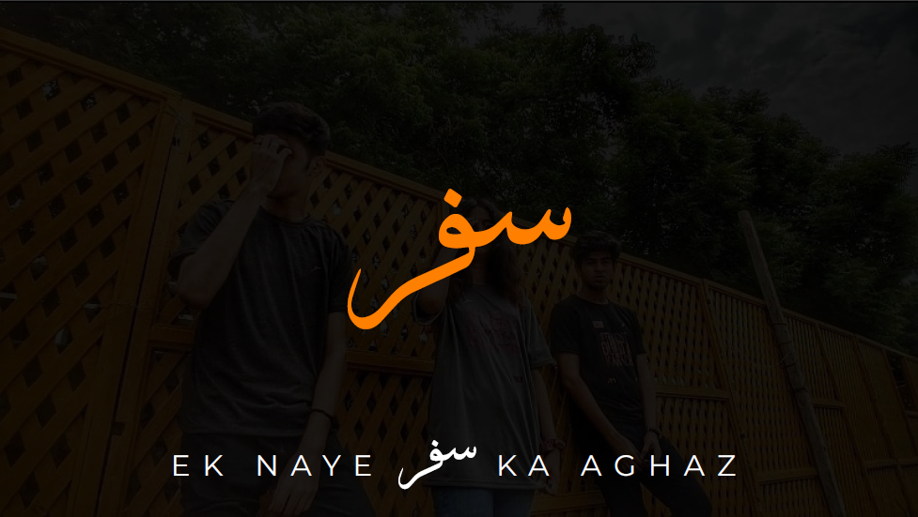
K A A G H A Z
زین شہزاد
20B-028-CS
علیزہ اعظم
20B-112-CS
افرا محمود
20B-049-CS
E K N A Y E

Slide 2
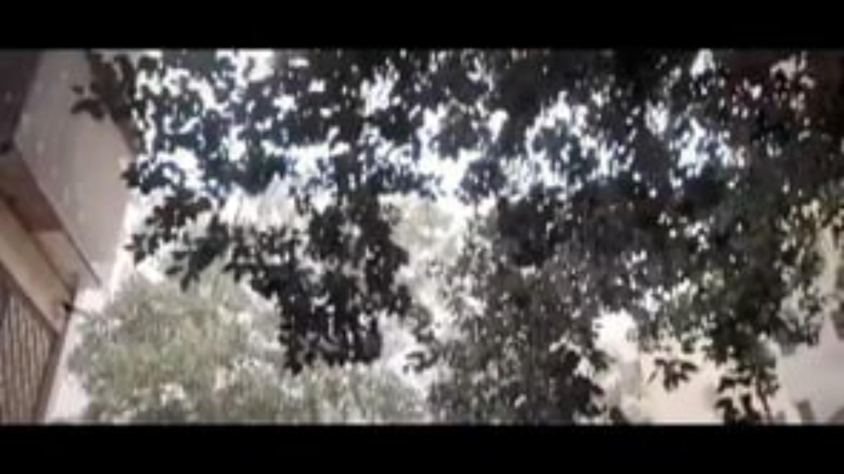
A d v e r t i s m e n t

Slide 3
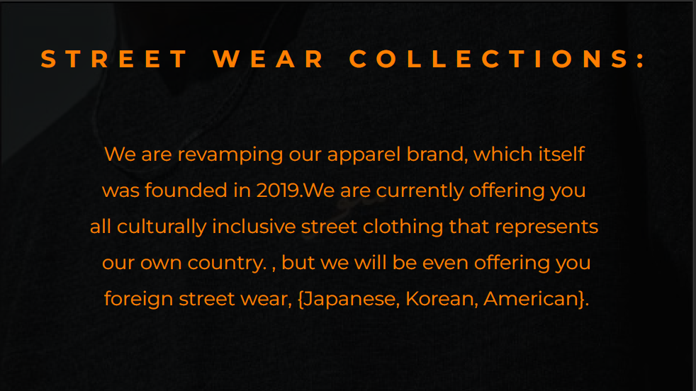
S T R E E T
W E A R
C O L L E C T I O N S :
We are revamping our apparel brand, which itself was founded in 2019.We are currently offering you all culturally inclusive street clothing that represents our own country. , but we will be even offering you foreign street wear, {Japanese, Korean, American}.

Slide 4
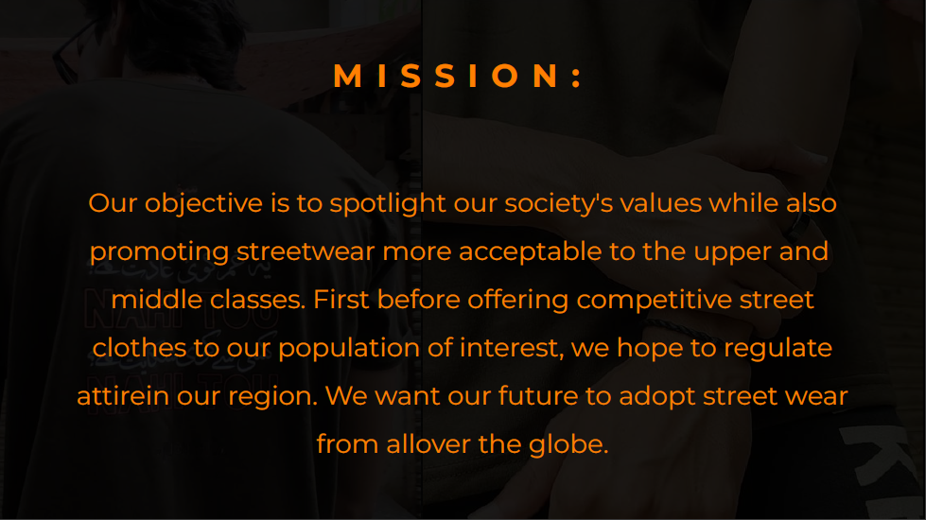
M I S S I O N :
Our objective is to spotlight our society's values while also promoting streetwear more acceptable to the upper and middle classes. First before offering competitive street clothes to our population of interest, we hope to regulate attirein our region. We want our future to adopt street wear from allover the globe.

Slide 5
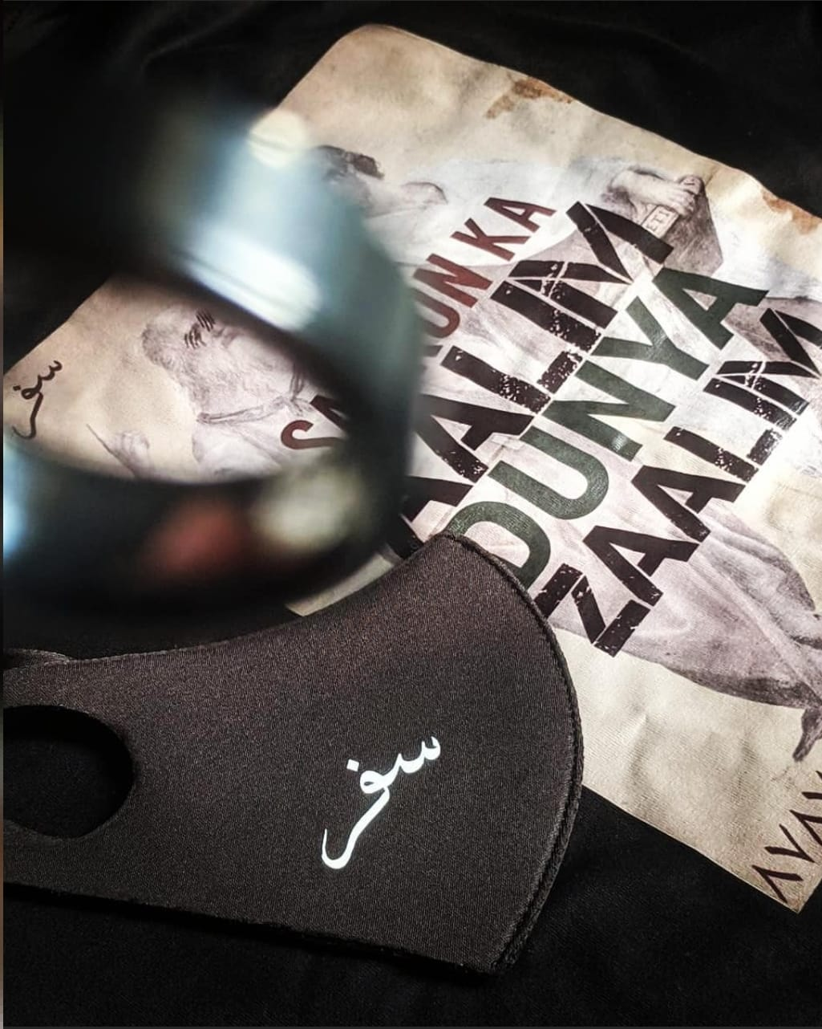
V a l u e P r o p o s i t i o n
Our value proposition is "Safar is not just a clothing brand; it's a style celebration. Our streetwear reflects different cultures, made with top-notch materials for comfort that doesn't break the bank. Designed in Pakistan, our versatile selection lets you express your unique style easily. More than clothes, Safar is about urban life's vibes and values. Easy online shopping and trendy designs make Safar your go-to for a stylish and comfy wardrobe that speaks volumes about who you are."

Slide 6
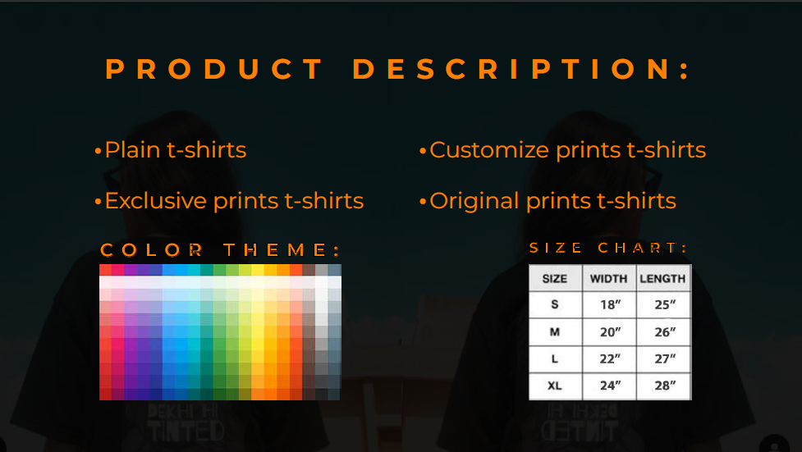




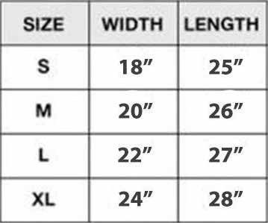
P R O D U C T
D E S C R I P T I O N :
Plain t-shirts
Customize prints t-shirts
Exclusive prints t-shirts
C O L O R T H E M E :
Original prints t-shirts
S I Z E C H A R T :

Slide 7
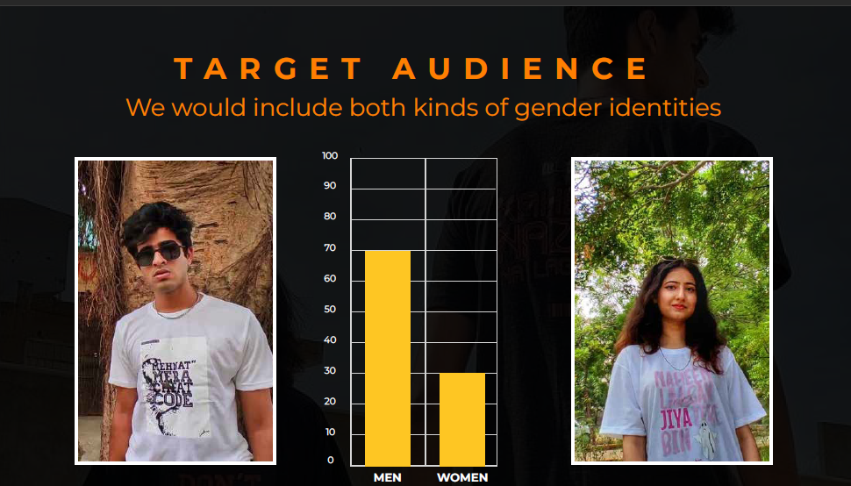
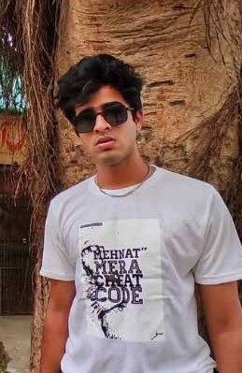
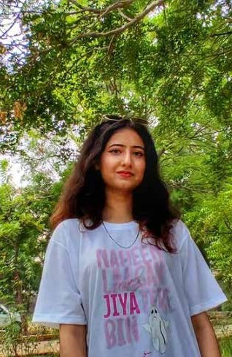
T A R G E T A U D I E N C E
We would include both kinds of gender identities

Slide 8
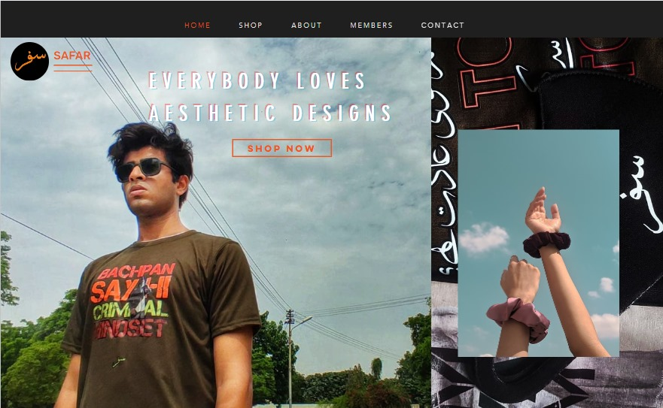
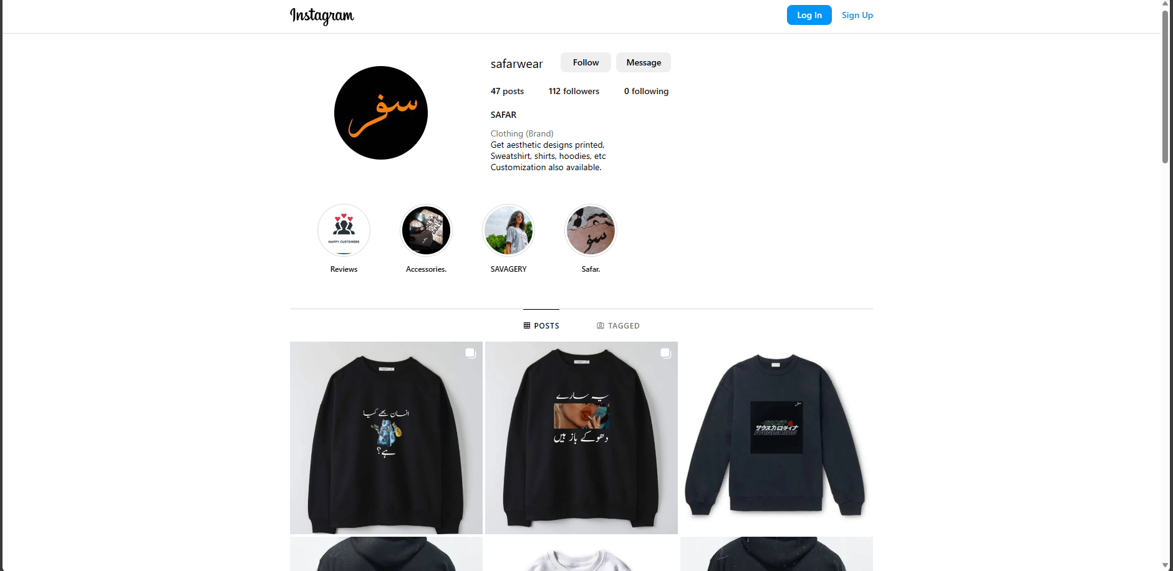
S a l e s C h a n n e l
In crafting our sales channel strategy at Safar, we've strategically aligned our brand with the contemporary landscape of e-commerce and direct sales through Instagram and our website. Our visually engaging Instagram page serves as a dynamic portal to our e-commerce platform, creating an immersive shopping experience for our diverse audience. Focused on user-friendly design and mobile optimization, our website is a seamless hub for exploring our culturally inclusive streetwear collections. Through strategic social media engagement and promotions, we aim to build a vibrant community around Safar. This multi-faceted approach ensures that our customers enjoy a convenient, secure, and culturally enriching journey, reinforcing Safar as a go-to destination for fashion enthusiasts globally.

Slide 9



U N I Q U E
S E L L I N G
P O I N T :
Superior material at decent cost
Highest values and most critial proﬁt margin.
Promote our culture, urban areas.

Slide 10
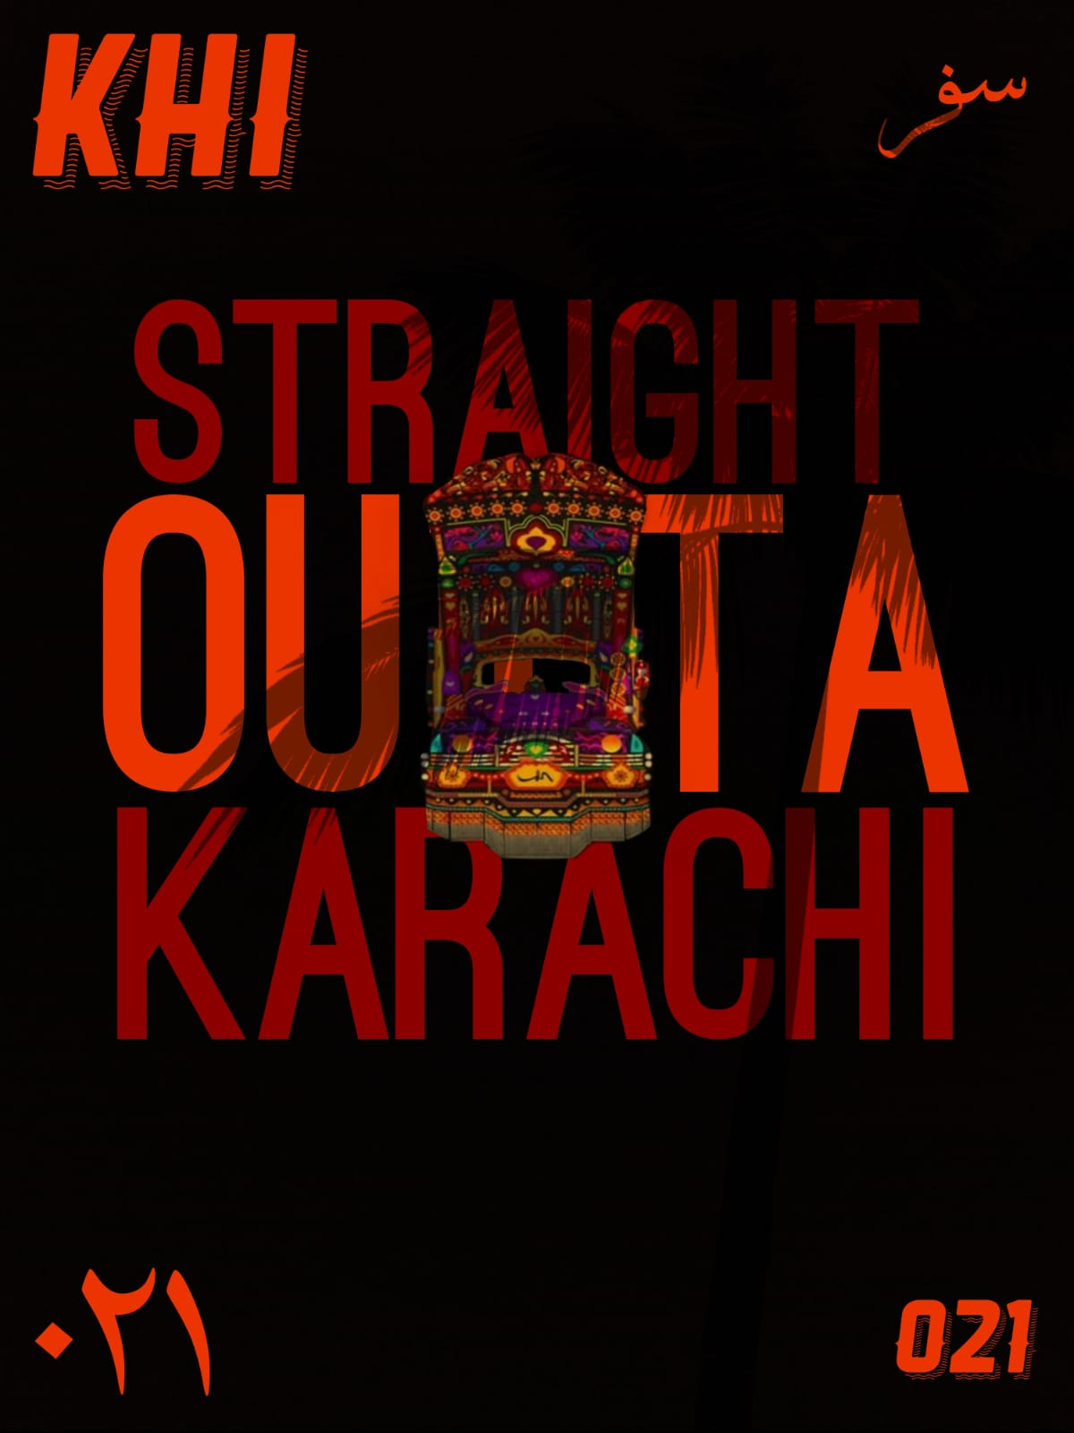
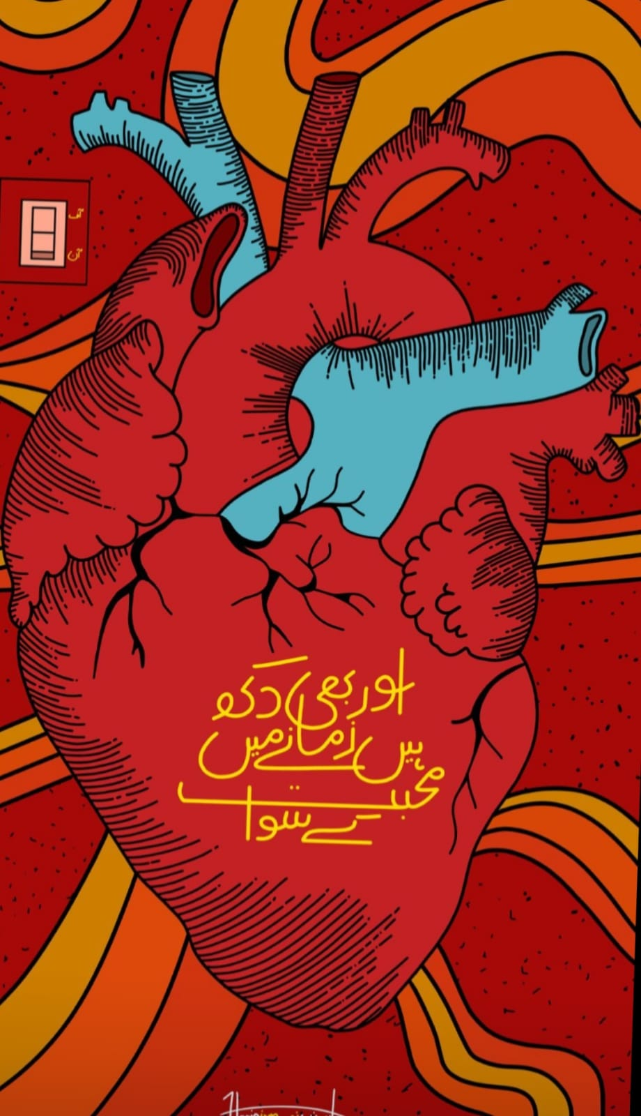
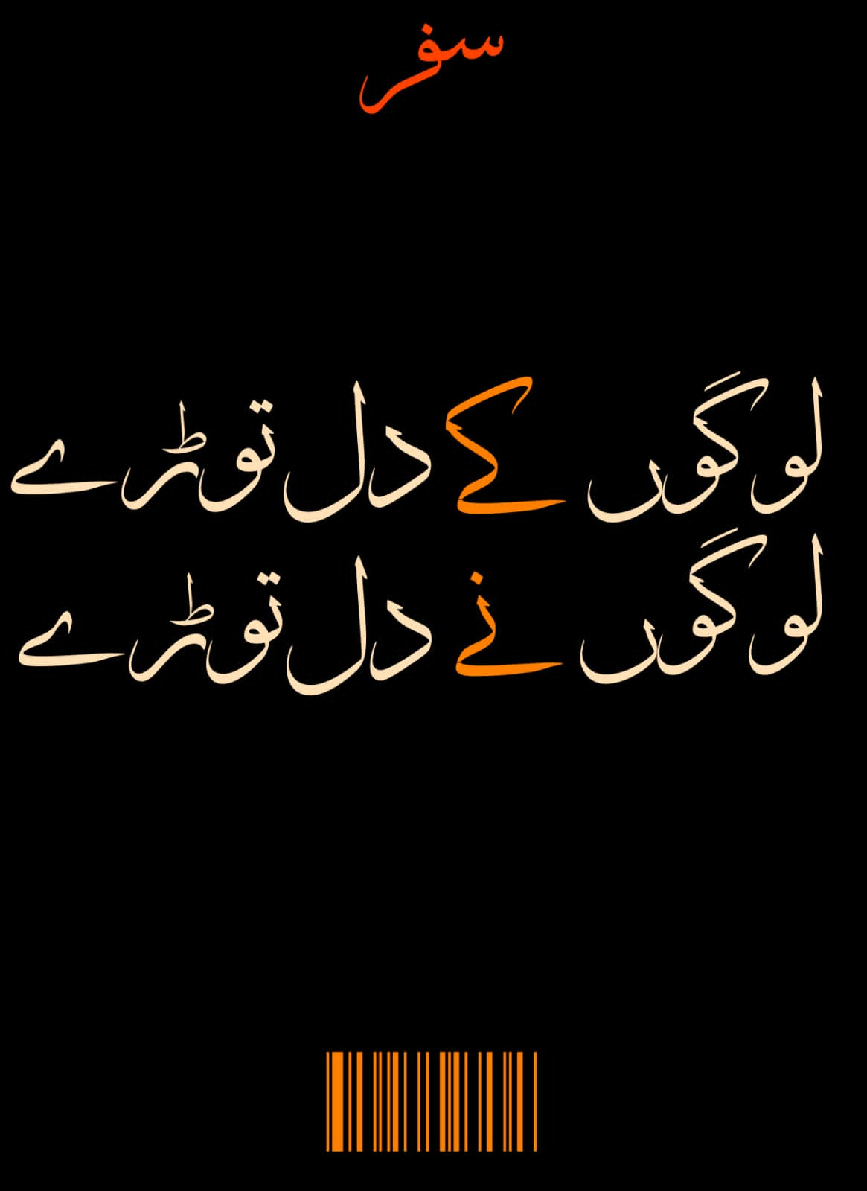
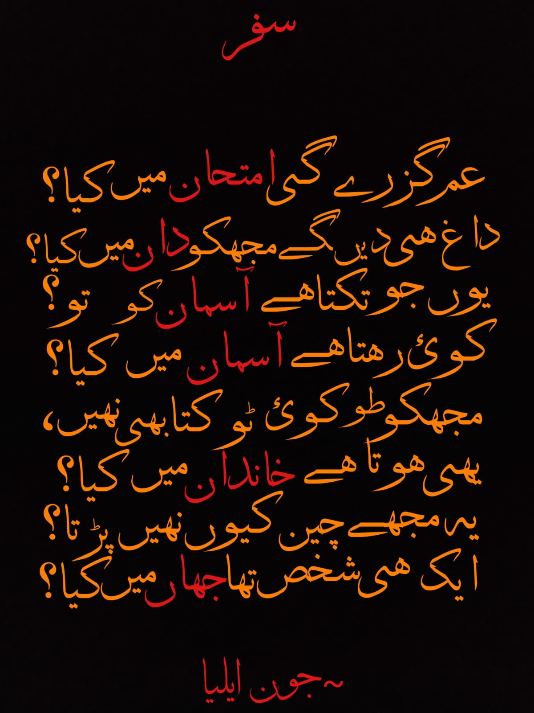
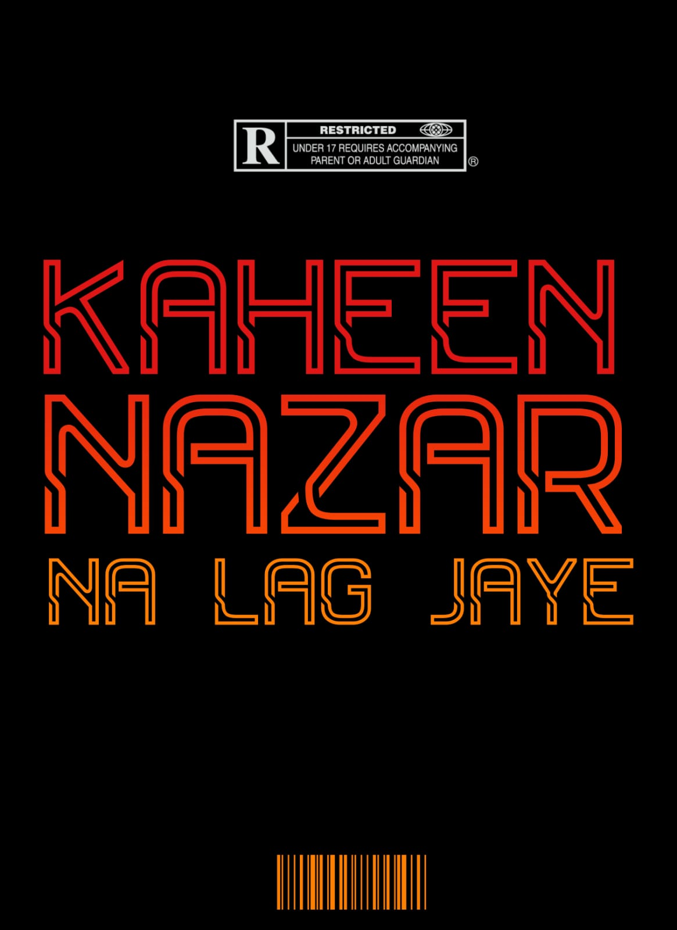
M e t h o d o l o g y
Make exclusive designs that resonate with our target audience and separates us from the crowd
Each design is the result of countless iteration and constant feedback loop

Slide 11
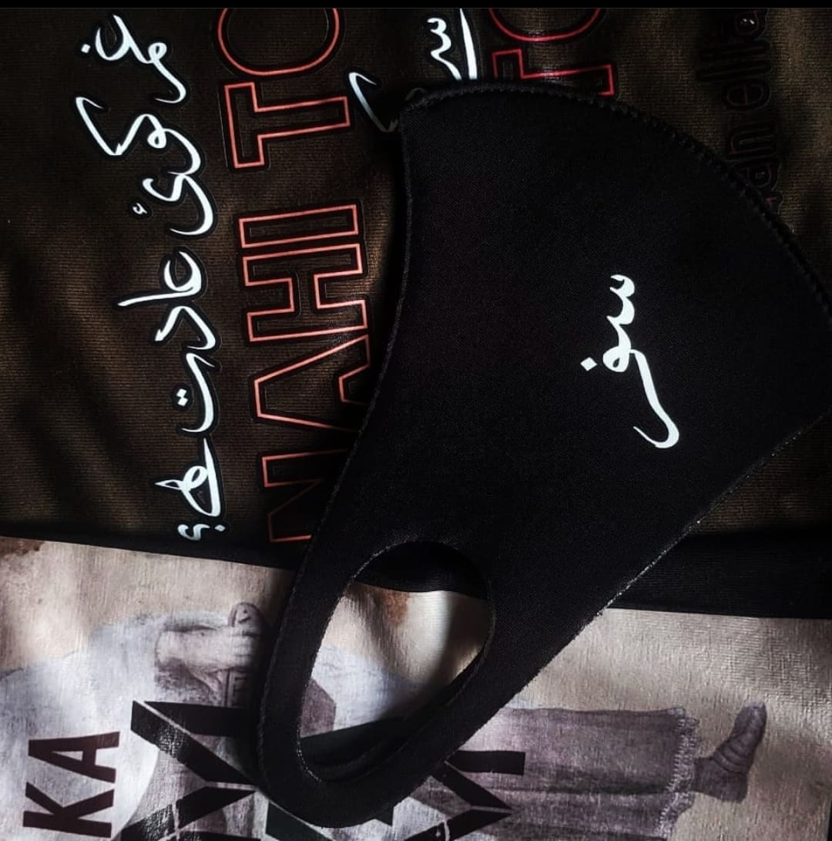
M e t h o d o l o g y
Designs are made by our in-house designers
Product is sourced from T-Shirt/hoodeis Wholesellers
A contractual professional printer then imprints these designs into the shirts/ hoodies

Slide 12
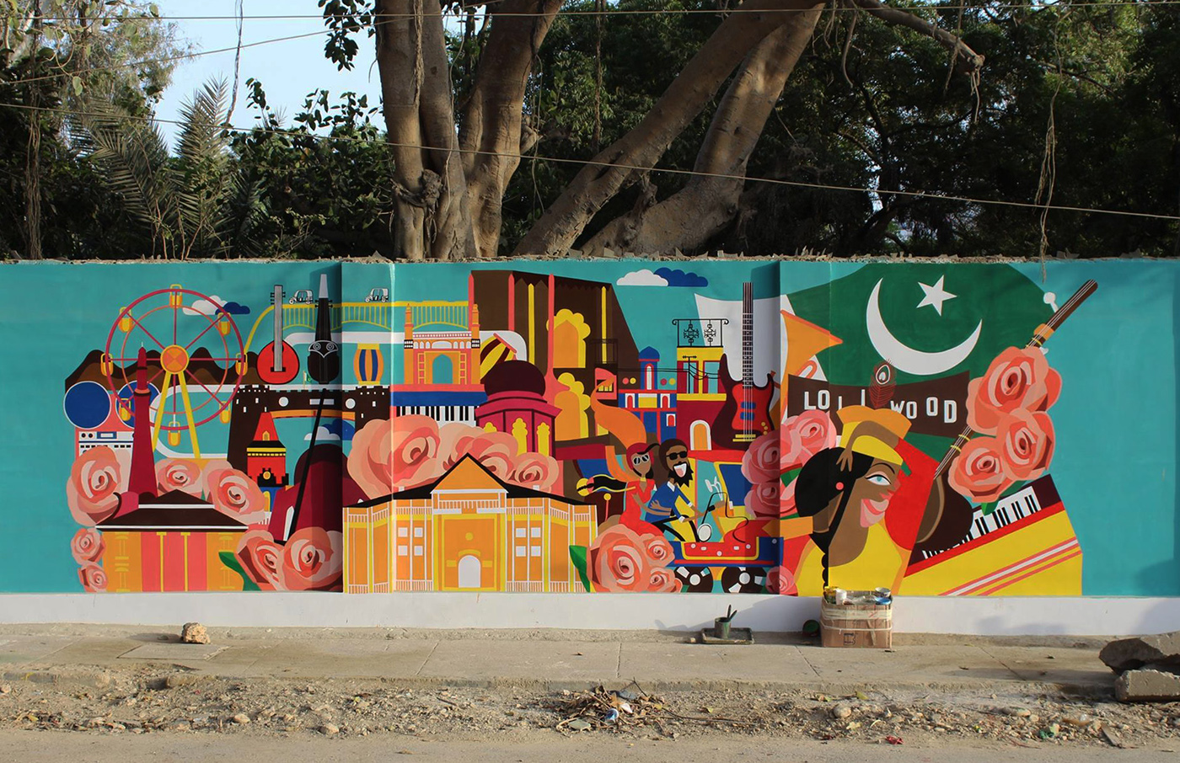
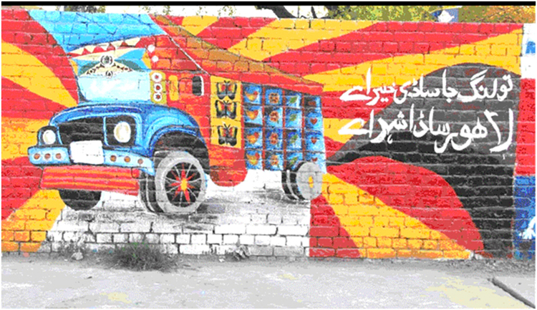
N i c h e / I n s p i r a t i o n
We used an entirely different approach when deciding to launch this brand. What if we used two of the most defining features about karachi?
Street Art
Love for Urdu Language
The result ? Safar!
In the next slide we will discuss the research data that led us to the conclusion that this business has the potential to grow

Slide 13
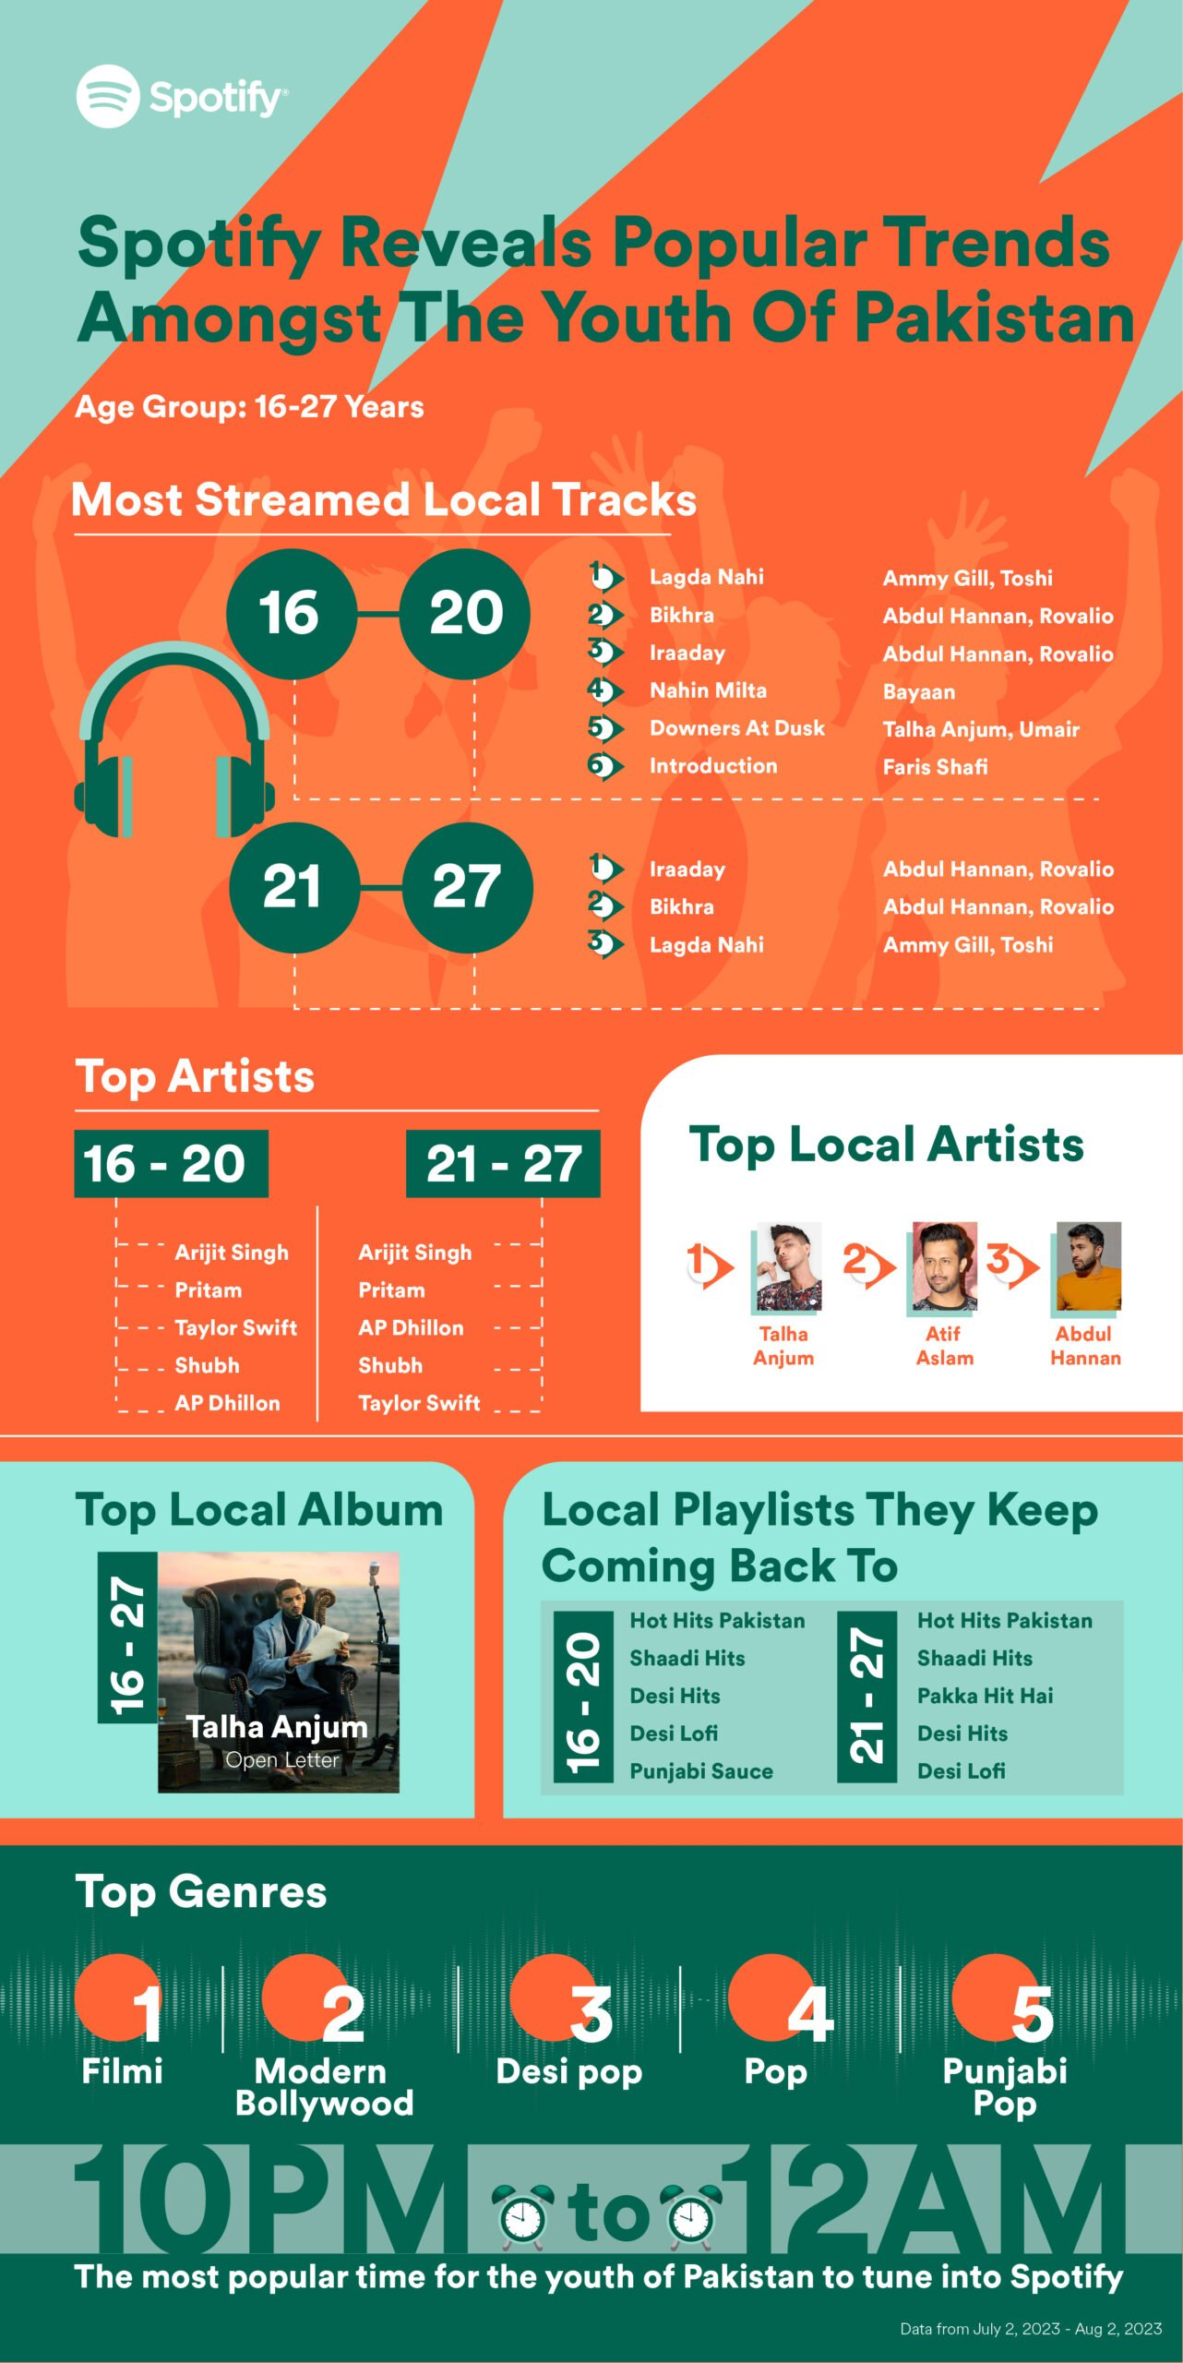
Pakistani Music Genre Urdu Hip Hop: A perfect outlet for our brand:
Artists in Pakistan, particularly in urban centers, have been incorporating Urdu lyrics and local flavors into their hip-hop music. Some key points about Pakistani Urdu hip-hop include:
Several emerging artists in Pakistan have embraced hip-hop as a means of expressing their thoughts, experiences, and social commentary. These artists often incorporate Urdu, Punjabi, or other regional languages in their lyrics to connect with the local audience.
Pakistani Urdu hip-hop often addresses social issues, political matters, and personal experiences. The lyrics can be a reflection of the challenges faced by the youth in Pakistan and provide a platform for artists to voice their opinions on various subjects.
Music videos often feature visuals that showcase different aspects of Pakistani culture, from traditional clothing and landscapes to urban settings, contributing to the visual representation of the country
Pakistani youth relates to hip-hop artists for the authenticity and relatability they bring to their music. The genre provides a platform for artists to express the challenges, aspirations, and experiences of the younger generation in Pakistan, making it a powerful medium for connecting with the audience. The use of Urdu and regional languages, along with themes addressing social issues, resonates with the lived realities of Pakistani youth, creating a sense of understanding and connection that goes beyond just entertainment. In a rapidly changing social and political landscape, hip-hop becomes a voice for the youth, reflecting their struggles, dreams, and cultural identity.

Slide 14
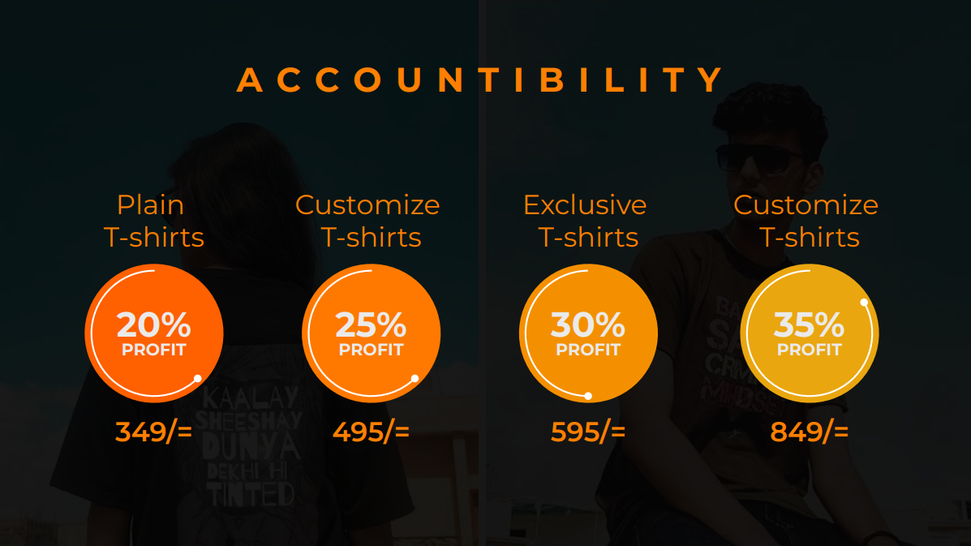


A C C O U N T I B I L I T Y
Plain T-shirts
Customize T-shirts
Exclusive T-shirts
Customize T-shirts
20%
25%
30%
35%
PROFIT
PROFIT
PROFIT
PROFIT
349/=
495/=
595/=
849/=

Slide 15
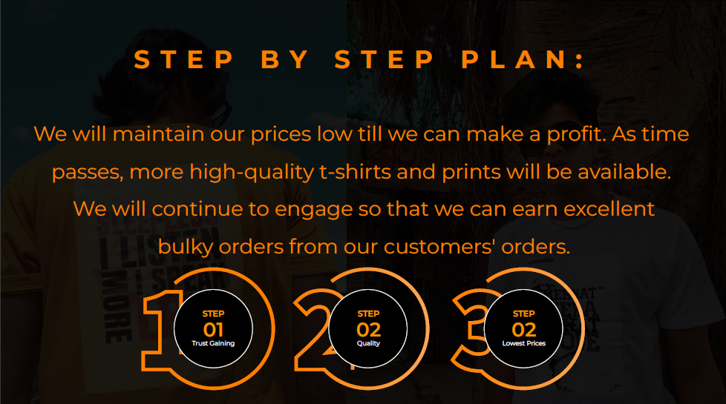



S T E P B Y S T E P P L A N :
We will maintain our prices low till we can make a proﬁt. As time
passes, more high-quality t-shirts and prints will be available.
We will continue to engage so that we can earn excellent bulky orders from our customers' orders.
STEP
01
Trust Gaining
STEP
02
Quality
STEP
02
Lowest Prices

Slide 16
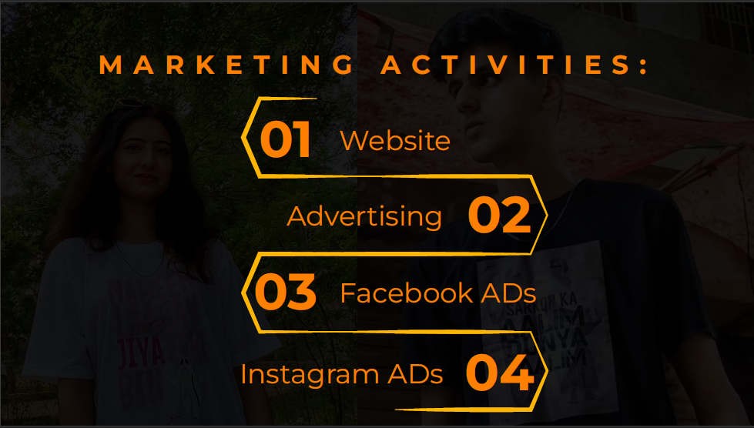
01
M A R K E T I N G A C T I V I T I E S :
Website
02
Advertising
03
Facebook ADs
04
Instagram ADs

Slide 17
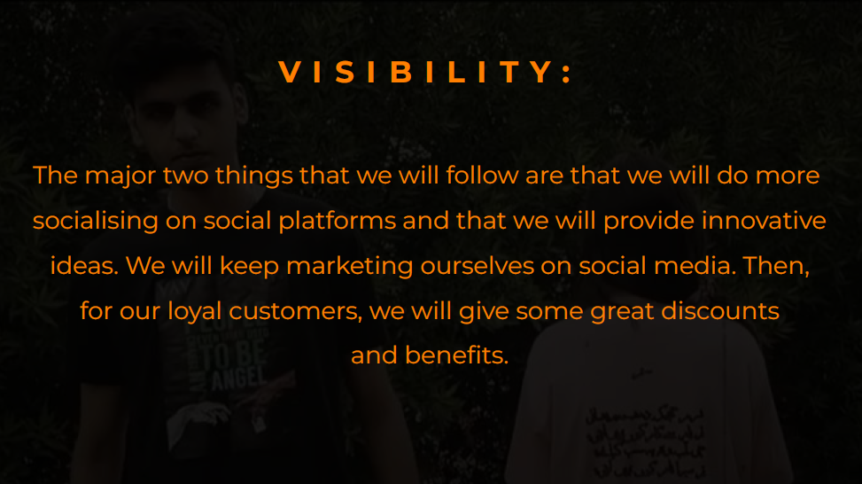
V I S I B I L I T Y :
The major two things that we will follow are that we will do more socialising on social platforms and that we will provide innovative ideas. We will keep marketing ourselves on social media. Then, for our loyal customers, we will give some great discounts
and beneﬁts.

Slide 18
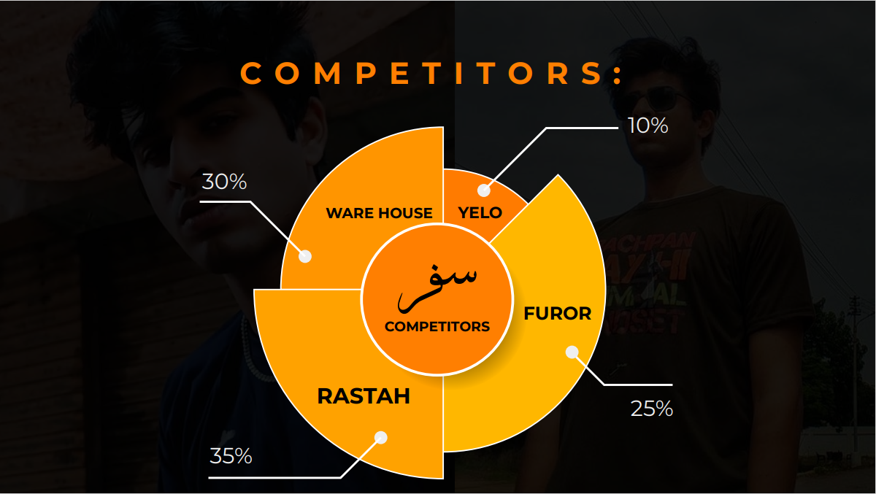


C O M P E T I T O R S :
10%
30%
WARE HOUSE
YELO
FUROR
COMPETITORS
RASTAH
25%
35%

Slide 19
Links:
Website: Error (iframahmood24.wixsite.com)
Instagram Page: SAFAR (@safarwear) • Instagram photos and videos

Slide 20
Thankyou!

